Slide 1


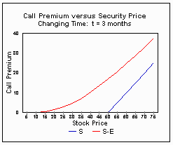
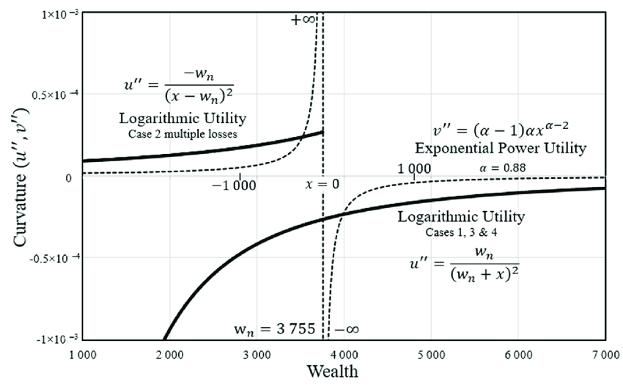
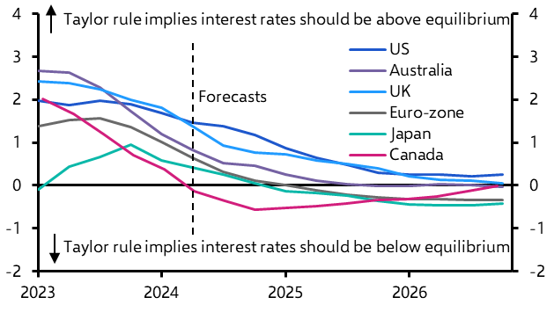

K. J. Somaiya School of Engineering, Mumbai – 400 077
Somaiya Vidyavihar University
Department of Science and Humanities
F.Y. B.Tech. Semester –II (2024-25)
Applied Mathematics-II
Internal Assessment-II
Real-Life Applications of Taylor's Series & Maclaurin Series in Economics & Finance
NAME : Dhruv Pankhania
ROLL NO. : 16010124216
DIV: C4 BATCH: 1
A mathematical tool used to approximate complex, non-linear functions with polynomials around a given point. This is extremely useful in economics and finance where exact solutions are hard to compute.
Maclaurin Series: special case of Taylor Series where expansion is around x=0x = 0x=0. f(x)=f(a)+f′(a)(x−a)+2!f′′(a)​(x−a)2+⋯
Utility Function Approximation Economists use Taylor Series to linearize utility functions (e.g., Cobb-Douglas, Log Utility).Helps in calculating marginal utilities, consumer choices, and optimization problems.
Option Pricing (Black-Scholes Model) Taylor Series used to approximate complex functions like the normal cumulative distribution and exponential terms in the Black-Scholes formula. Enables faster numerical computation of option prices.
Forecasting & Taylor Rule Central banks use Taylor Rule to set interest rates:
Derived from linear approximations of economic models using Taylor series.
Reference: Varian, H. R. (2014). Intermediate Microeconomics (9th ed.) -https://books.google.com/books/about/Intermediate_Microeconomics_with_Calculu.html?id=9mabDwAAQBAJ
Reference: Taylor, J. B. (1993). Discretion vs Policy Rules in Practice. -https://web.stanford.edu/~johntayl/Onlinepaperscombinedbyyear/1993/Discretion_versus_Policy_Rules_in_Practice.pdf

